Slide 1
Addressing Synchronization Problem in CTng Local Testing Environment

Slide 2
CTng – improved version of Certificate Transparency
A redesign of traditional certificate transparency proposed by Prof Amir Herzberg
Goal : Achieve Certificate transparency and Revocation Transparency with the following Principles:
Not Trust Third Party: All the entities are not trusted in our network (Loggers, Certificate Authorities, Monitors and Gossipers)
Allow offline Validation
Denial of Service attack (DOS) resiliency

Slide 3
Digital Signature
Cryptographic Output used to verify the authenticity of data
Protection against tempering
Sign the message using the secret key
Verify the message using the public key
(with no knowledge of the secret key)

Slide 4
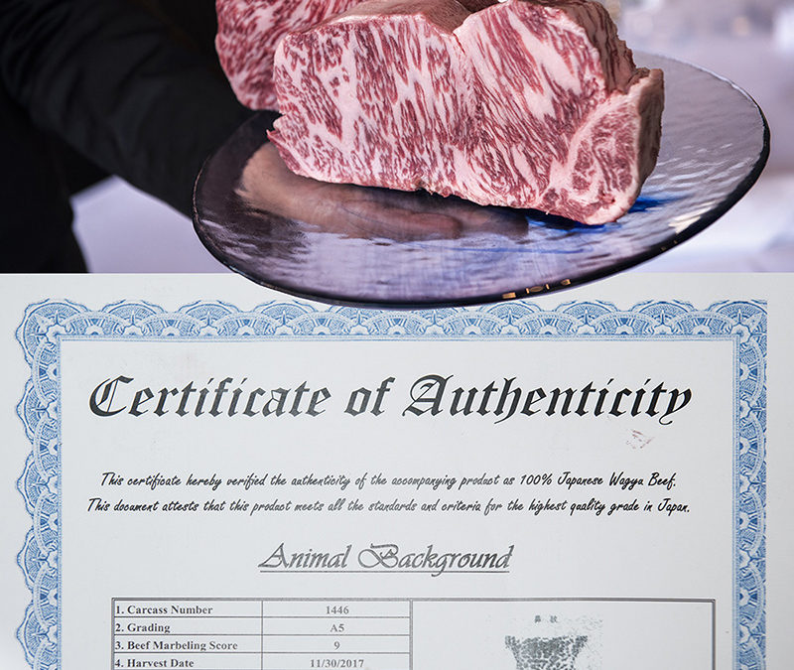
Certificate
A Certificate is issued by a Certificate Authority to the domain owner who have requested it and have proven its identity to the Certificate Authority
A simple example of a certificate for domain owner A:
(“PK_A||A||Expiration Date”, Signature(SK_CA, m))
PK_A: The Public Key of A
SK_CA: Secret Key of the Certificate Authority
m = “PK_A||A||Expiration Date”
Signature(SK_CA, m) = CA’s signature over m using its Secret Key

Slide 5
With the certificate
Client Bob wants to establish a connection with domain A
A will send the certificate to Bob
Bob will then be able to verify the Public Key of A Using the public key of the CA
Since Bob knows the certificate (“PK_A||A||Expiration Date”, Signature(SK_CA, m))
And the public key of the CA
Problem：
CAs are the Trusted Entities here
But they are essentially just businesses

Slide 6
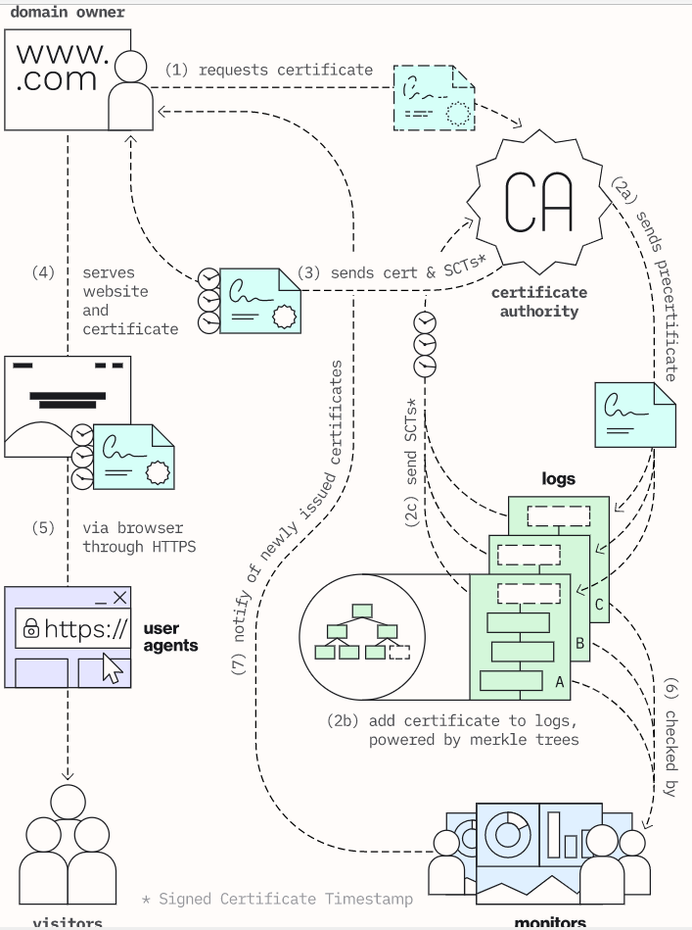
Certificate Transparency
Each Valid Certificate will be logged by a logger using an append
only structure (the Merkle Tree)
This allows public monitoring and auditing
Website owner request certificate from CA
CA issues pre-certificate (Certificate without CT info) and send it to loggers
Loggers return SCTs to the CA to show the commitment to add the precerticate within the MMD
CA attaches the SCTs to the Certificate as part of the message that will be signed by the CA and send to the domain owner
Domain owner then send the certificate to the browser
…….

Slide 7
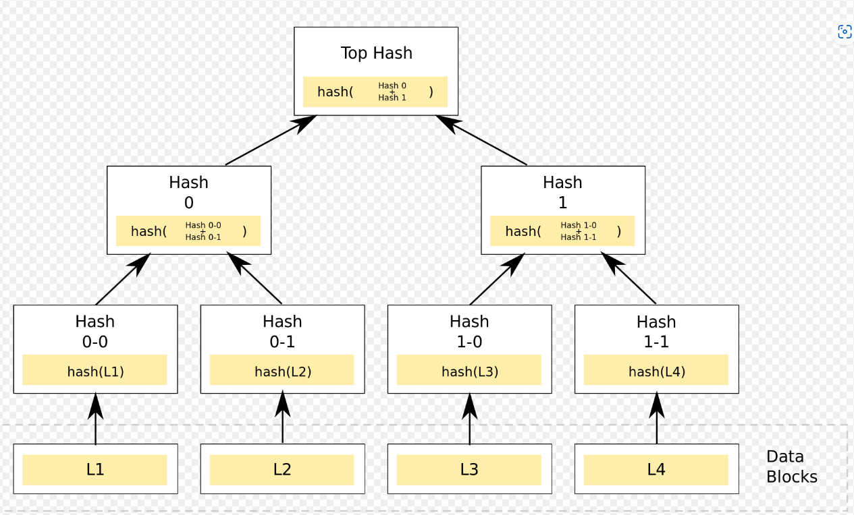
Monitor and Logger in CT
Logger (CT log)
Anyone can query whether a certificate is included in a logger
When the logger signs the Root Merkle tree (Periodically), it creates a Signed Tree Head (STH)
Verify(Cert + POI(cert)) = STH
Monitor
Monitors can be ran by anyone
A CT monitor is often a subscription service

Slide 8
CTng
Monitor → Monitor–Gossiper network with Threshold Signature
Threshold Signature Scheme (TSS)
A signer group where any subsets of (Threshold size)of the group can produce signatures on behalf of the group.
Multi Signatures
are threshold signatures that they reveal the
identities of the group members who produced them. In multi signatures, the signing
members are not anonymous at all.
DOS resiliency → TSS does not require all monitor’s signature to generate a full signature
NTTP → TSS requires at least Threshold number of signature for full authentication
Offline Validation → monitor synchronization with group authenticated data for client
→ Client only need to query one monitor once per period to get all the updated info

Slide 9
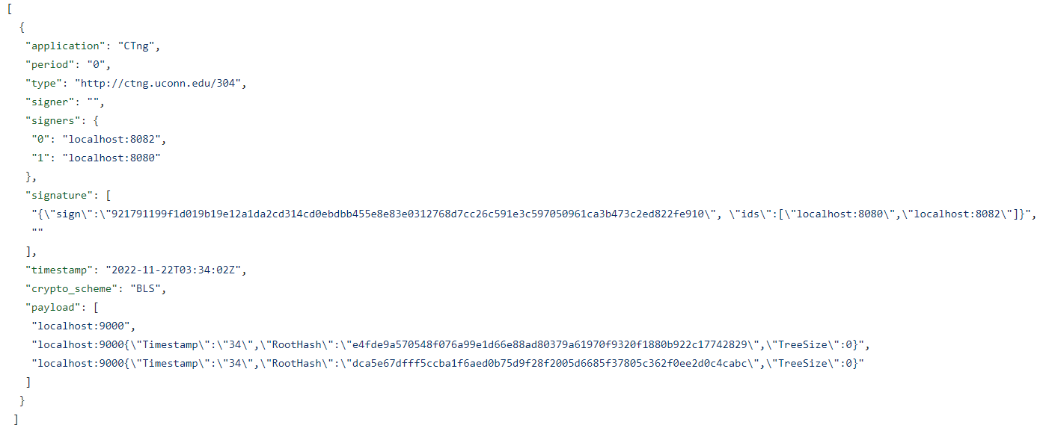
TSS–BLS
Gen:
Sign:
Given a message m and the provided
secret key share 𝑘;
each participant i generates a partial signature 𝑆 = 𝐻(𝑚) ⋅ 𝑘;
Verify:
Verify partial sig (participants are exposed)
Verify Aggregated sig

Slide 10
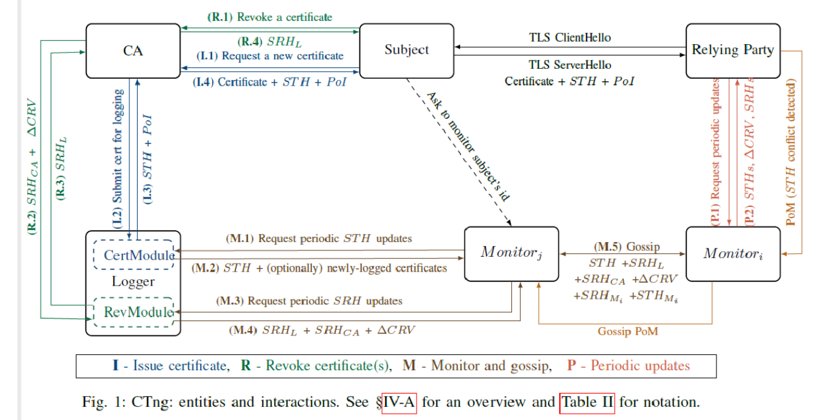
Overall structure (tentative)

Slide 11
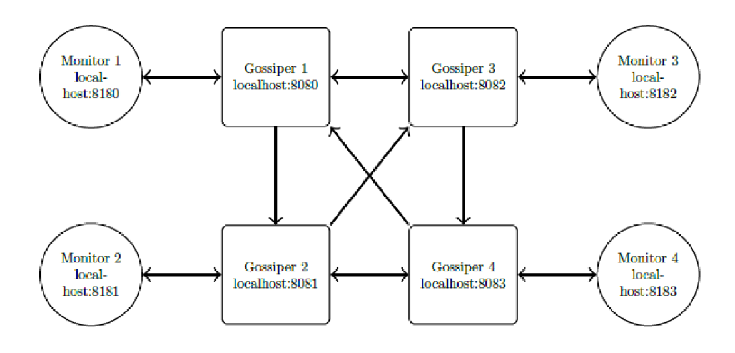
This Project

Slide 12
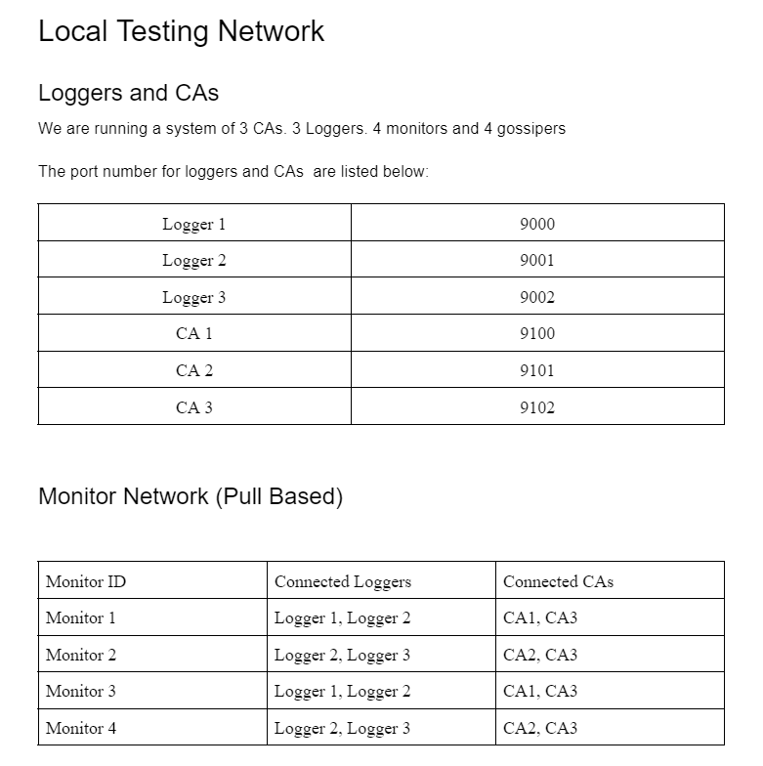

Slide 13
Note:
In this Project
The monitors query the CAs for revocation information instead of the revocation module of the logger (because the design for both the CA and the Logger has not been finalized and has not been fully implemented)
Monitors only query monitors and CAs once period (Pull based)
We use different port on the machine to simulate different physical machines (each entity should be ran on a separate machine in real life application)

Slide 14
Goal of Monitor-Gossiper Synchronization
All the monitors must have the CTng information to serve the client, regardless of the CAs/loggers this single monitor queries.
E.g. Monitor 1 queries Logger 1
Monitor 2 queries Logger 2
Monitor 1 and Monitor 2 need to have the same group authenticated information from both Logger 1 and Logger 2 to serve the client

Slide 15
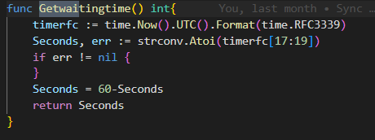
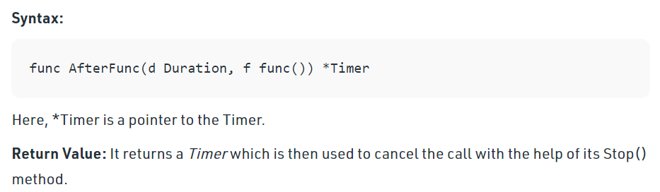
Monitor Query
Use sleep to make sure every Monitor Queries at the same time
Periodic query is implemented by time.Afterfunc

Slide 16
File I/O
Uses the Golang os package
provides a platform-independent interface to operating system functionality
Unix-like design
Go-like error handling (more information available)
The os interface is intended to be uniform across all operating systems. Features not generally available appear in the system-specific package syscall.
Use cases are in util/IO
Interface:
func ReadByte(filename string) ([]byte, error) {}
func WriteData(filename string, data interface{}) error {}
func CreateFile(path string) {}

Slide 17
“Multithreading” and Shared resources
Gossiper communication are push based
Everytime the GossipData function is called, a new goroutine (light weighted thread) will be created
Everytime a Gossiper receives an data object, the Handler will run through a duplication check before assigning the data received to the specific handlers
Data-specific handlers will store the object before processing it for future duplication checks
Duplication check will need read access to the storage
Store object will need write access to the storage

Slide 18
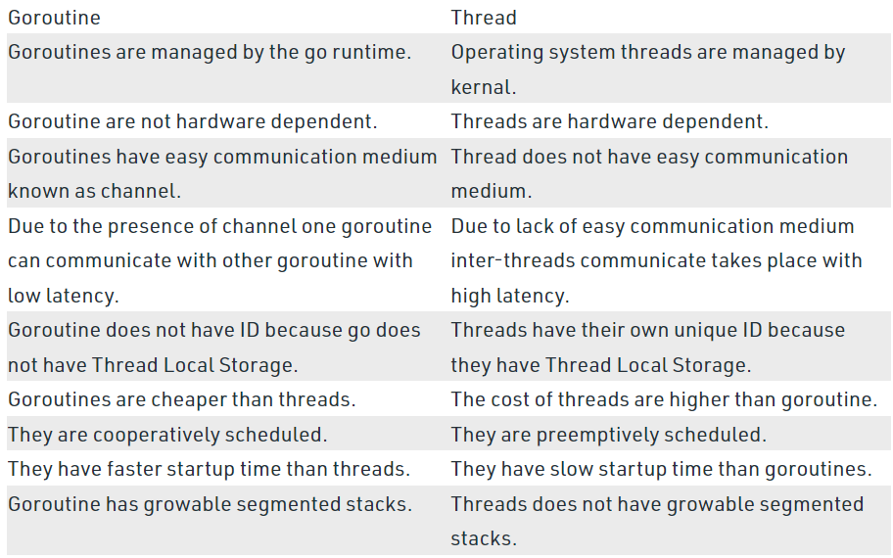
Goroutine vs Thread

Slide 19
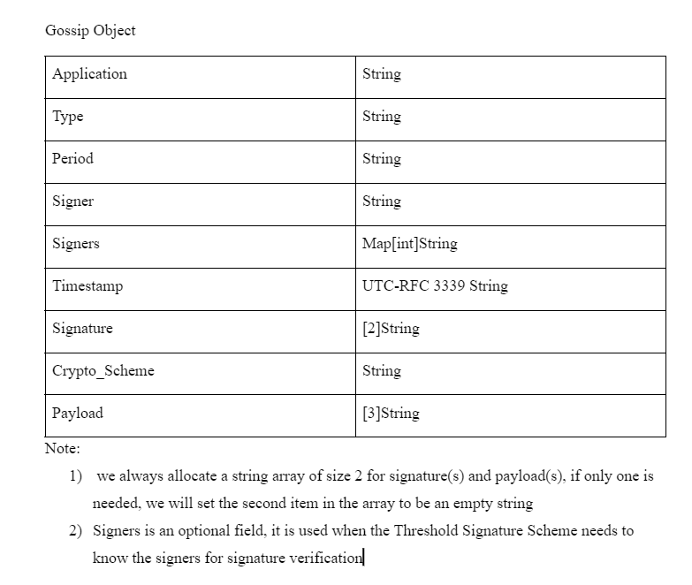
Data Structure Transferred

Slide 20
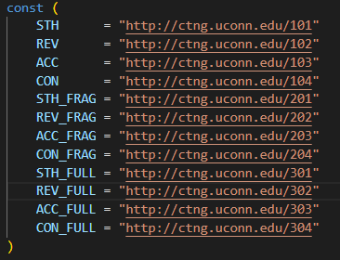
Data being transferred in this project
STH, REV are signed by Loggers and CAs
ACC is signed by the monitor
CON is not signed, but the payload of the CON contains 2 signature from the conflicting objects
(So it can still be verified)
[wildcard]_FRAG are signed by the monitors in old design, by the gossipers in the new design
[wildcard]_FULL are generated by the gossipers by aggregating threshold hold number of partial signatures
Note:
CON_FRAG, CON_FULL, ACC Do not exist in the old design because the monitor will produce ACC_FRAG straight away and CON_FRAG, CON_FULL will never be generated due to fact that monitors are responsible for threshold signing while CON is generated by the gossiper
All data transferred are protected by digital signature and are therefore verifiable

Slide 21
Old Design - Monitor Each Period
Monitors query loggers/CAs (with no PoM held against) for STH/REV information
Monitors send STH/REV (or ACC_FRAG if Queried Loggers/CAs are not responding) to their connecting gossipers and wait for gossip_wait_time(A configurable constant that should be changed according to the information propagation delay in the network)
→ Generate STH_FRAG/REV_FRAG (= sign the STH/REV with Monitor’s BLS partial signature) Otherwise and send to its gossiper
→ Do nothing if there is a PoM against the original signer of STH/REV
Receives STH/REV/CON(If applicable)/ACC_FULL(if Applicable) from its gossiper
Prepare the Client update, store all the group authenticated data (File I/O, json encoding)

Slide 22
Old Design - Gossiper Each Period
Upon receiving any non-duplicate data, the Gossiper should first store it, invoke the data-specific handler and then gossip it to other gossipers it connects to
For any non-duplicate STH/REV/CON received (with Logger/CA’s signature, not yet signed by any gossipers), the gossiper will send it to the monitor and gossip it its connected gossipers
For any non-duplicate STH_FRAG/REV_FRAG/ACC_FRAG received, the gossiper will increment its counter by 1 if the counter reaches the threshold while no fully signed version is yet stored, the gossiper should generate corresponding STH_FULL/REV_FULL/ACC_FRAG c and send it to the monitor (Also gossip it to other gossipers)

Slide 23
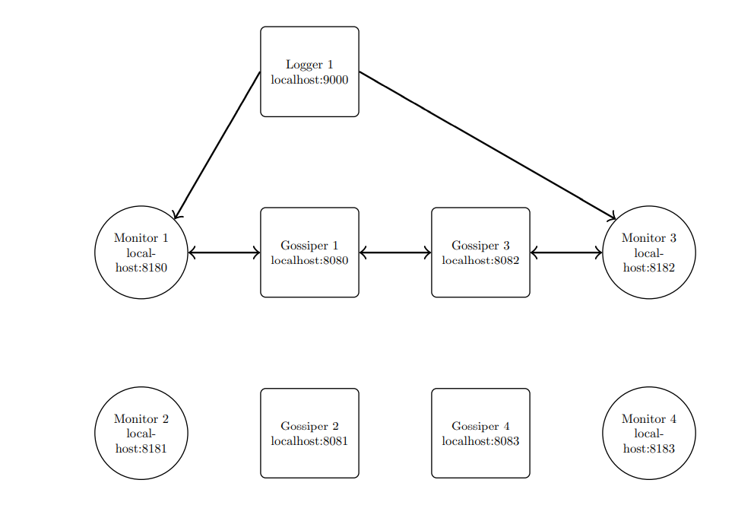
Old Version: Monitor responsible for Threshold Signing
Case Config
Threshold = 2
Total monitor-gossiper = 4
If Logger 1 is an honest logger, it will send the same STH to both monitor 1 and monitor 3
M1 can get STH from L1 and G1
G1 can get STH from M1 and G3
G1 can get STH_FRAG from M1 and G3

Slide 24
Problem:
Shared Resource on both monitors and gossipers
Duplication check will need read access to the storage
Store object will need write access to the storage
Many Goroutine will need read and write access to the storage (monitor and gossiper)
The data structure we use for storage is map
Which is not a thread-safe implementation

Slide 25
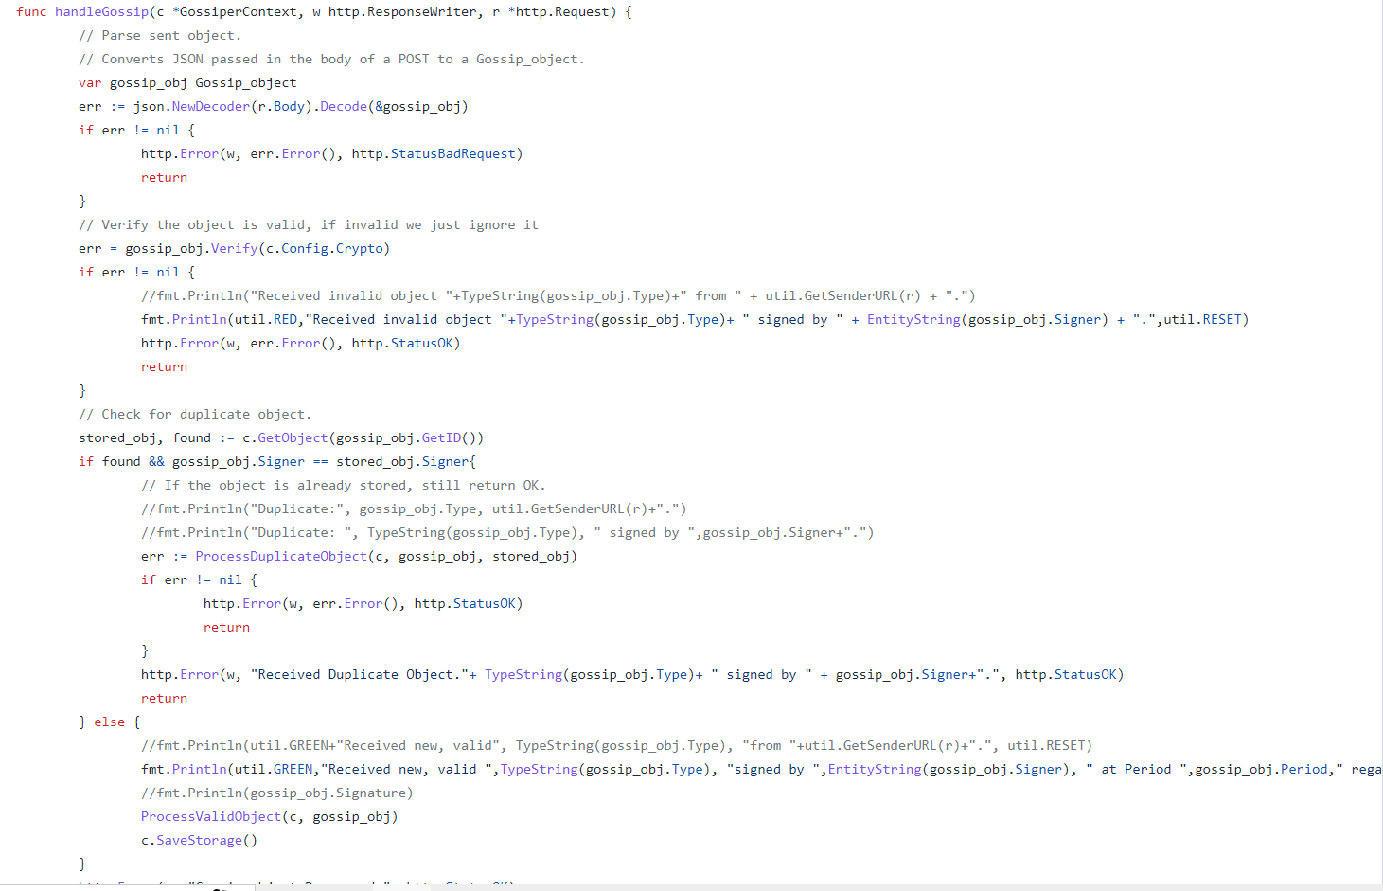
Old design General Object Handler

Slide 26
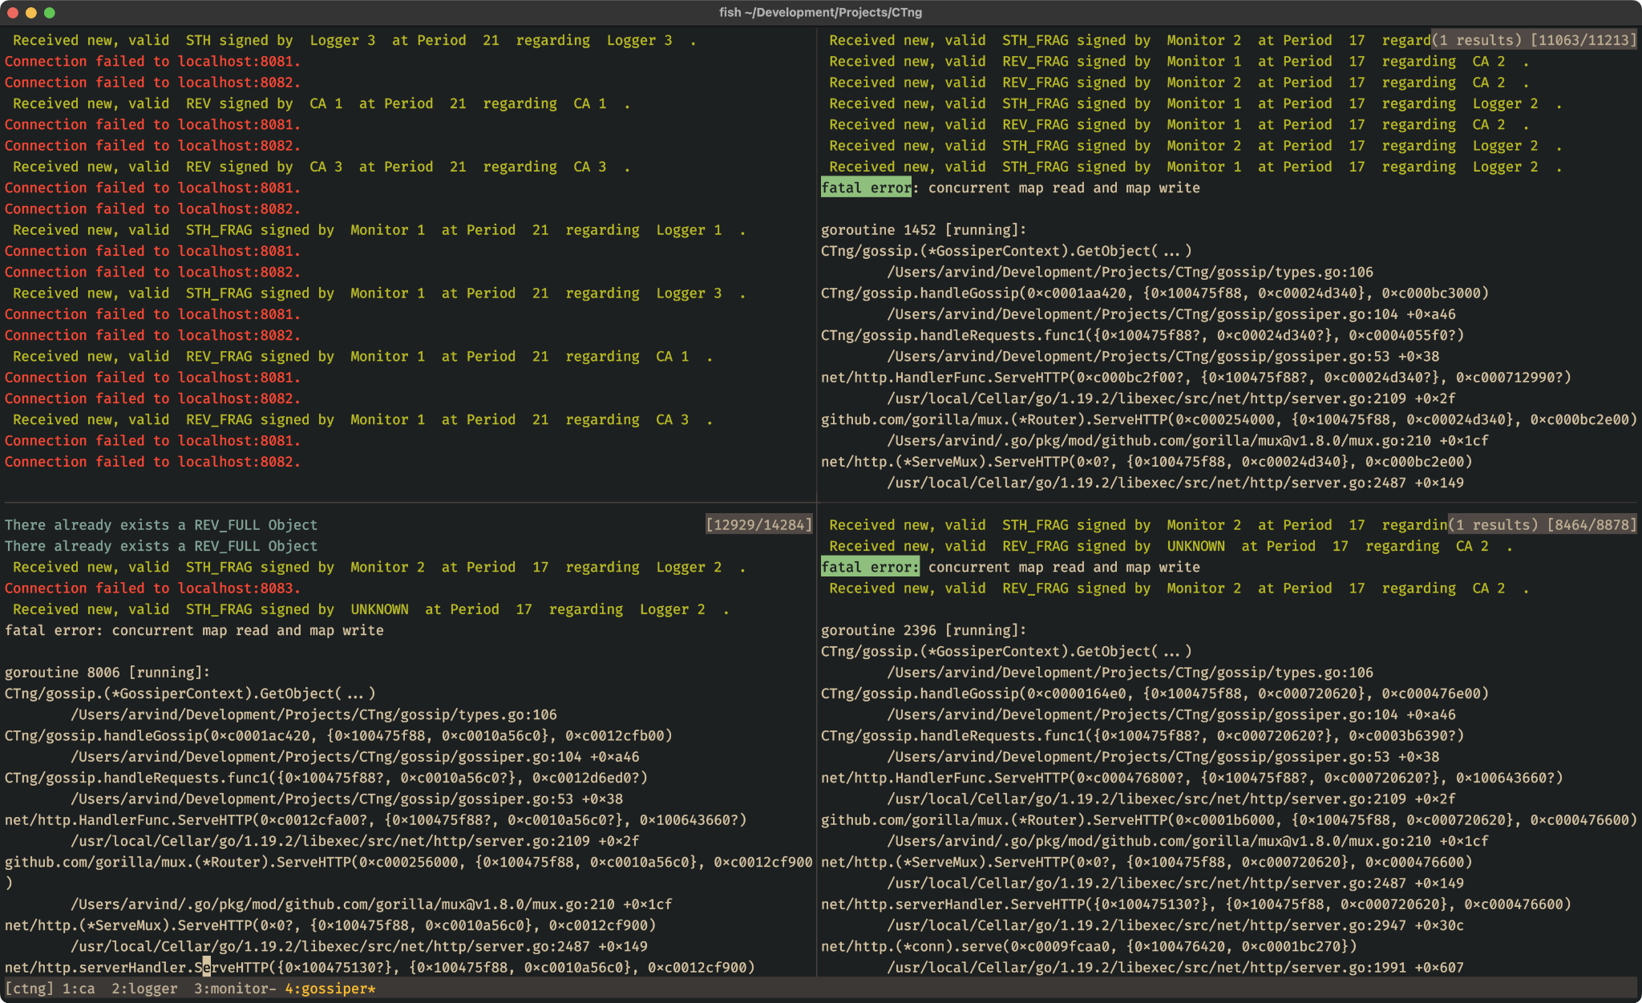
Concurrent Map Read and Write

Slide 27
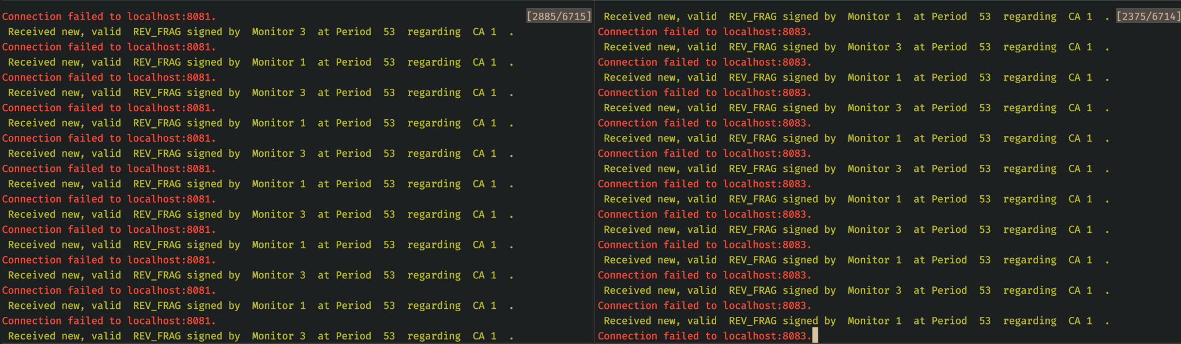
Race condition
Bypassing the duplication check

Slide 28
Problem
Need thread safe implementation
→ synchronization primitives
Options:
Sync.RWmutex
A RWMutex is a reader/writer mutual exclusion lock. The lock can be held by an arbitrary number of readers or a single writer.
Sync.Map is optimized for two common use cases:
when the entry for a given key is only ever written once but read many times, as in caches that only grow
when multiple goroutines read, write, and overwrite entries for disjoint sets of keys.
→ failed attempt on the old design
→ causing a deadlock or causing a significant performance drop which undermines the security assumption

Slide 29
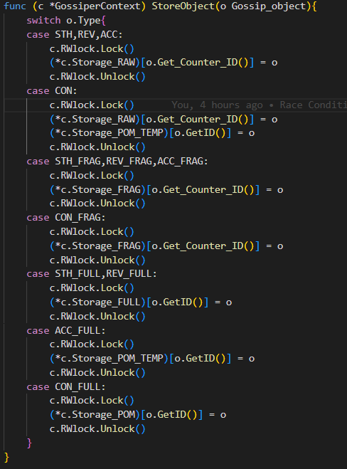
Solution – Hybrid Approach
Move the threshold sign functionalities from the monitors to the gossipers
→ This means we only need to think about concurrency control on the gossipers
Use RWmutex to make sure Other gorouine’s Read/ Write Access are blocked while we are try to store the data
Making sure the critical section is short

Slide 30
Monitors Each Period
Monitors query loggers/CAs for STH/REV information
Monitors send STH/REV (or ACC if Queried Loggers/CAs are not responding) to their connecting gossipers
Receives STH_FULL, REV_FULL, ACC_FULL(if applicable),CON_FULL (if applicable) from its gossiper
Prepare the Client update, store all the group authenticated data (File I/O, json encoding)
Note:
Gossiper-Monitor is a always pair
ACC will have Monitor’s signature (Non-TSS) on it while STH/REV has Logger/CA’s signature

Slide 31
Gossipers Each Period
Upon receiving any non-duplicate data, the Gossiper should first store it, invoke the data-specific handler and then gossip it to other gossipers it connects to
For any non-duplicate STH/REV received (with Logger/CA’s signature, not yet signed by any gossipers), the gossiper should wait for Gossip_wait_time (A configurable constant that should be changed according to the information propagation delay in the network),
→ generate CON (Proof of misbehavior for Conflicting info) if a Conflicting STH/REV is received
→ Generate STH_FRAG/REV_FRAG (= sign the STH/REV with Gossiper’s BLS partial signature) Otherwise
For any non-duplicate ACC/CON received, follow the same procedure as STH/REV except no conflict check is needed, because gossipers don’t produce STH/REV/ACC themselves and CON has internal verification mechanism
For any non-duplicate STH_FRAG/REV_FRAG/ACC_FRAG/CON_FRAG received, the gossiper will increment its counter by 1 if the counter reaches the threshold while no fully signed version is yet stored, the gossiper should generate corresponding STH_FULL/REV_FULL/ACC_FRAG/CON_FRAG c and send it to the monitor (Also gossip it to other gossipers)

Slide 32
Sample Run
Topology: 3 loggers 3 CAs 4 monitors 4 gossipers
Running entities: Logger 1 , CA 1 , Monitor 1, Monitor 3, Gossiper 1, Gossiper 3
Malicious Entity: Logger 1 → sending conflicting STHs to Monitor 1 and Monitor 3
Unresponsive entities: Logger 2, Logger 3, CA 2, CA 3
Expected Output per period:
ACC_FULL = 4 (should stay at 4 because ACC_FULL is considered as temporary PoM and the cache will be wiped each period)
STH_FULL = 0 (should stay at 0 since the monitor will not query Loggers with PoM on file)
REV_FULL = 1 (+1 each period)
CON_FULL = 1 (should stay at 1)

Slide 33
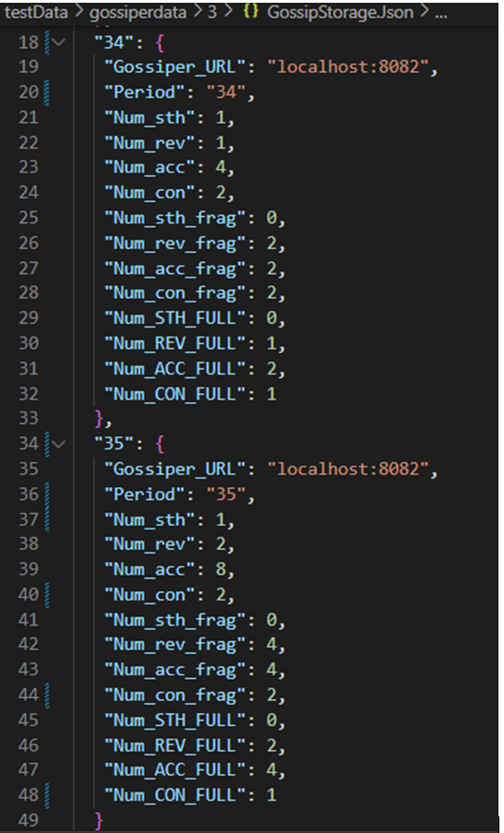
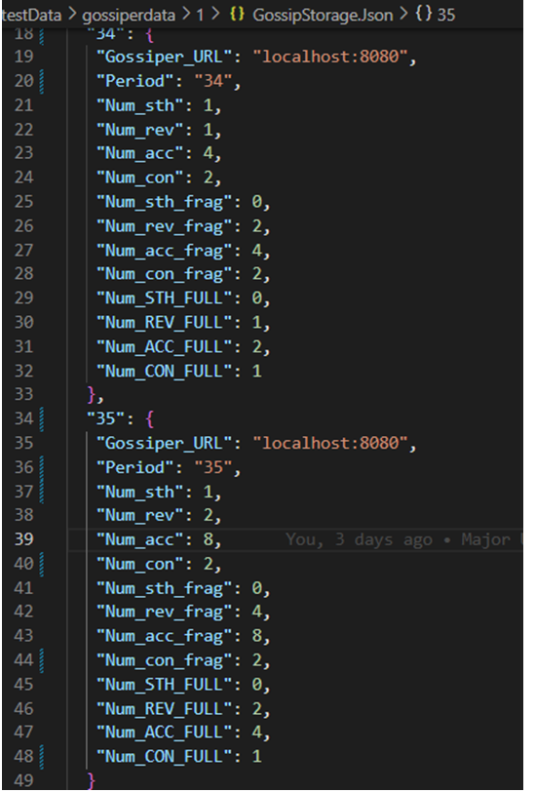
Gossiper 3
Gossiper 1

Slide 34
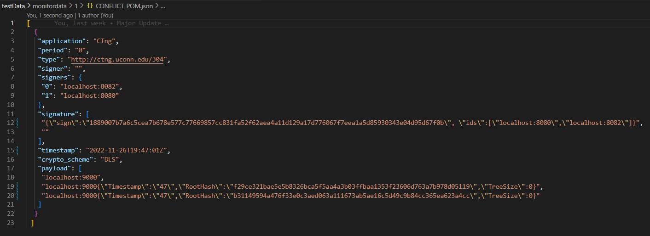
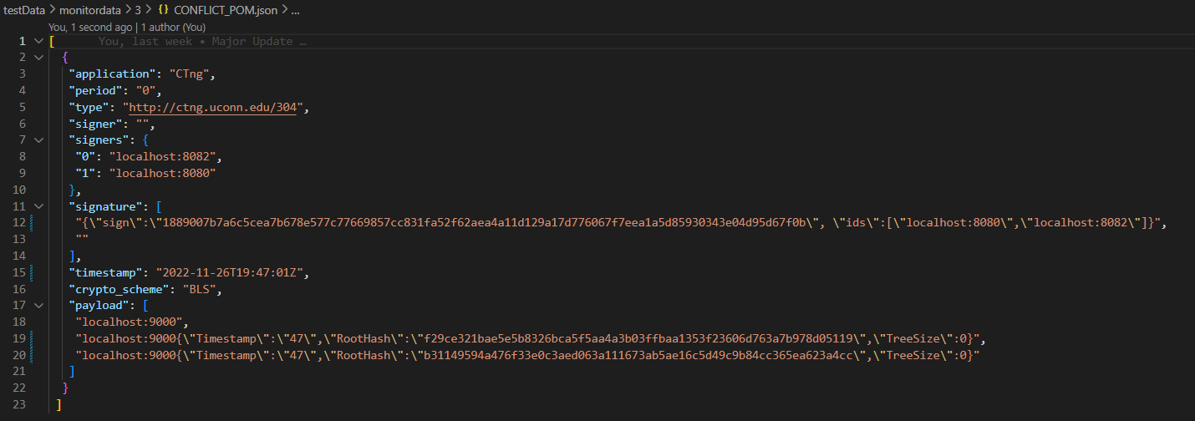
Monitor 1:
CON_FULL
Monitor 3:
CON_FULL

Slide 35
Sources
Certificate of Authenticity for the 100% Japanese Wagyu Beef served at Greystone - Wagyu Beef | San Diego Steakhouse | Best in Gaslamp (greystonesteakhouse.com)
SSL Precertificates: What They Are & What They Do (thesslstore.com)
How CT Works : Certificate Transparency
Golang | Goroutine vs Thread - GeeksforGeeks
sync package - sync - Go Packages
time.AfterFunc() Function in Golang With Examples - GeeksforGeeks
os package - os - Go Packages

